Slide 1
UNIT – II DESIGN AND ANALYSIS OF ALGORITHMS

Slide 2
DISJOINT SETS

Slide 3
DISJOINT SET OPERATIONS
Definition : Sets are represented as a collection of well-defined objects or elements and it does not change from person to person. A set is represented by a capital letter symbol and the number of elements in the finite set is represented as the cardinal number of a set.
Disjoint Sets : If two sets are A and B and there is no element that is in both A and B then both these sets are called disjoint each other.
Ex: A ={ 1,3,5,9} and B = { 2,4,6,8} are disjoint sets.
Set Operations :
Union : The union of sets A and B denoted by A V B is the set defined as
A ˅ B = {x / x ϵ A or x ϵ B }
A = { 1,2,3,4} and B = {1,3,5,6}
A ˅ B = { 1,2,3,4,5,6}
Intersection : The intersection of sets A and B , denoted by A ˄ B, is the set defined as A ˄ B = { x / x ϵ A and x ϵ B }
A = { 1,2,3,4} and B = {1,3,5,6}
A ˄ B = { 1,3}

Slide 4
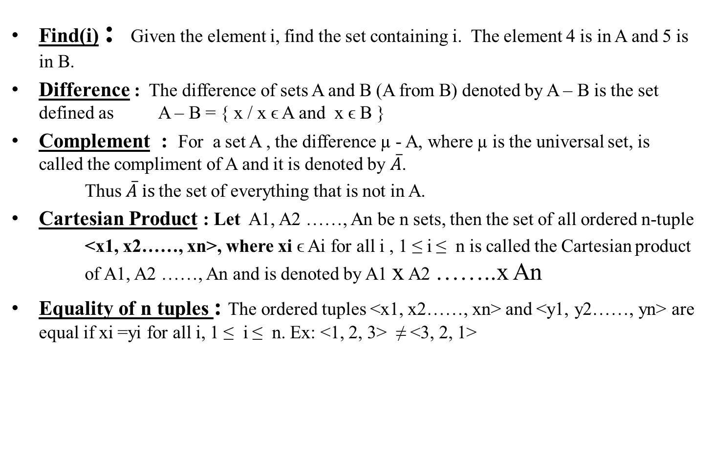
DISJOINT SET OPERATIONS

Slide 5
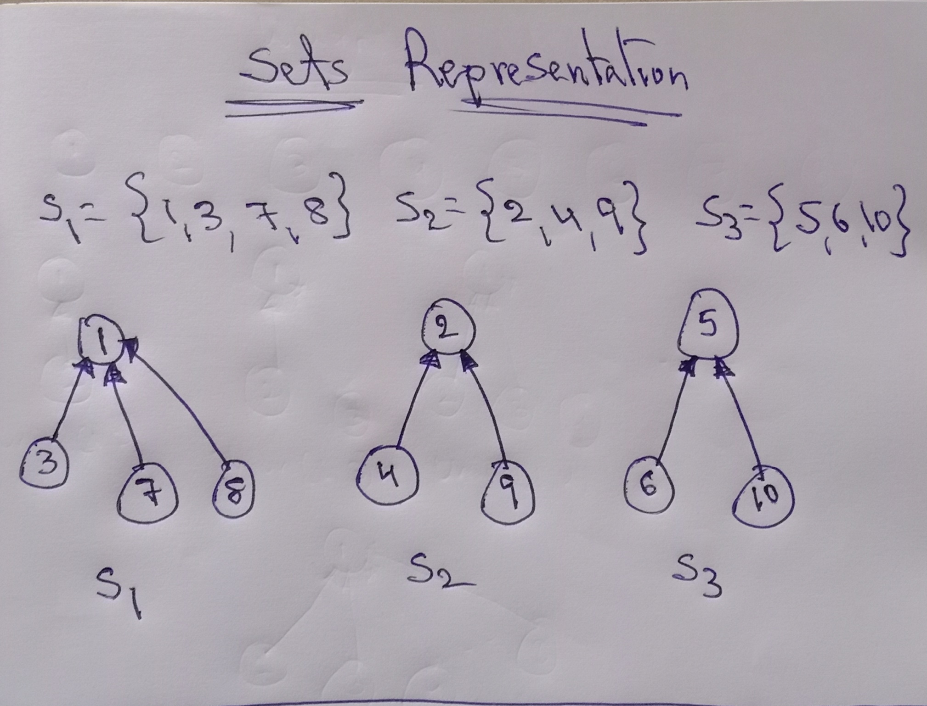

Slide 6
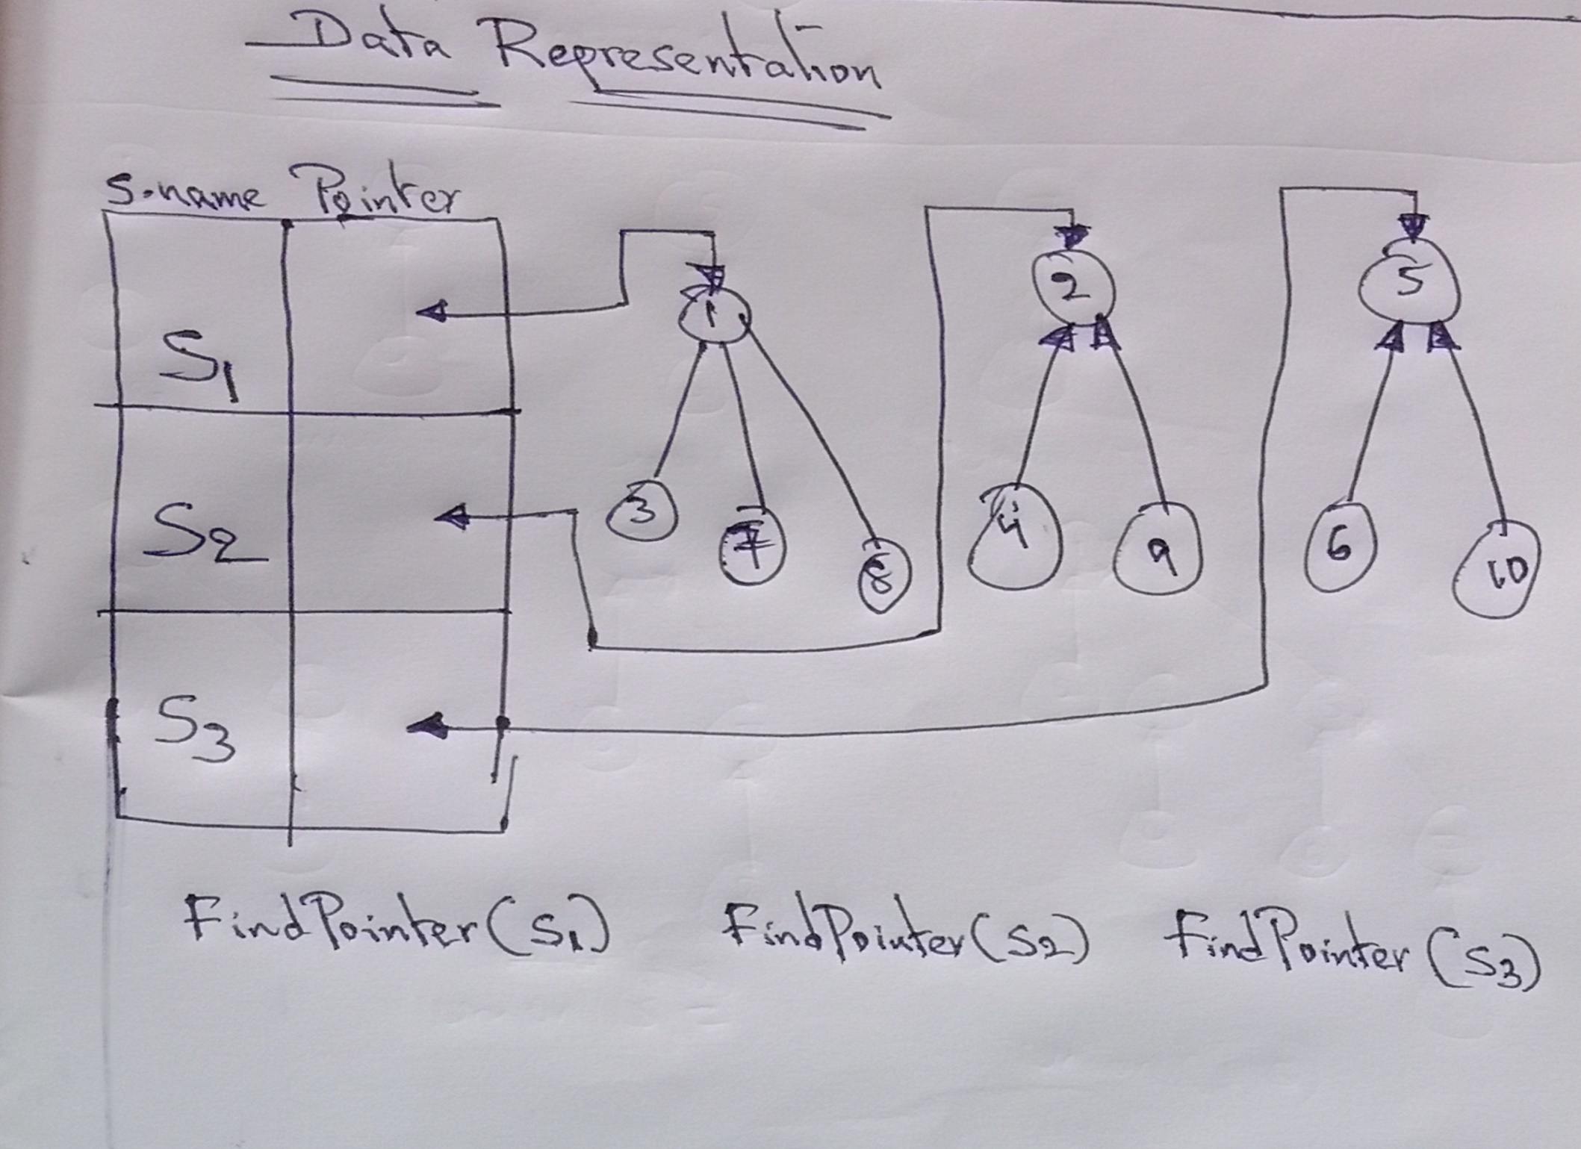

Slide 7
DISJOINT SET OPERATIONS
UNION : To obtain the Union of two sets, set the parent field of one of the roots to the other root.
This can be accomplished easily, if with each set name, we keep a pointer to the root of the tree representing that set.
Each root has a pointer to the set name, then to determine what set an element is currently in. We follow parent link to the root of its tree and use the pointer to the set name.
If we determine that the element i is in a tree with root j, and j has a pointer to k in the set name table, then the set name is just name[k].
If we wish to unite sets Si and Sj, then we wish to unite the sets with roots FindPointer(Si) and FindPointer(Sj). Here FindPointre( ) is a function that takes a set name and determine the root of the tree that represent it.
In many applications the set name is the element at the root.
The function Union(i, j) requires two trees with roots i and j be joined.

Slide 8
DISJOINT SET OPERATIONS
Union(i, j) is very simple. We pass in two trees with roots i and j. Adopting the convention that the first tree become a subtree of the second. The statement p[i] = j accomplishes the union.
Algorithm SimpleUnion(i, j)
{
p[i] := j;
}
Algorithm SimpleFind(i)
{
while(p[i]>0) do
i := p[i];
return i;
}
The above algorithm performance characteristics are not very good.
If you start with 9 elements each in a set of its own ( si = {i}, 1 ≤ i ≤ 9). Then the initial configuration consists of forest with 9 nodes, and p[i] = 0, 1 ≤ i ≤ 9.
Now process the below sequence of Union-Find operations : Union(1, 2), Union(2, 3), Union(3, 4) …… Union(8, 9). And Find(1), Find(2) …… Find(9).

Slide 9
DISJOINT SET OPERATIONS
Now process the sequence of Union-Find operations for n elements : Union(1, 2), Union(2, 3), Union(3, 4) …… Union(n-1, n). And Find(1), Find(2) …… Find(n).
The sequence results in the final tree structure as below:
Union(1, 2)
.
Union(2,3) .
.
n
2
n-1
1
3
2
2
1
1

Slide 10
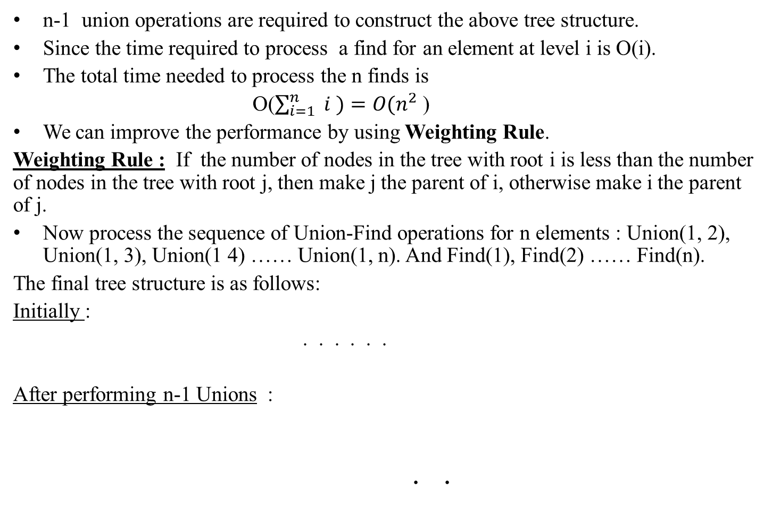
DISJOINT SET OPERATIONS
1
2
3
n
1
2
n
3

Slide 11
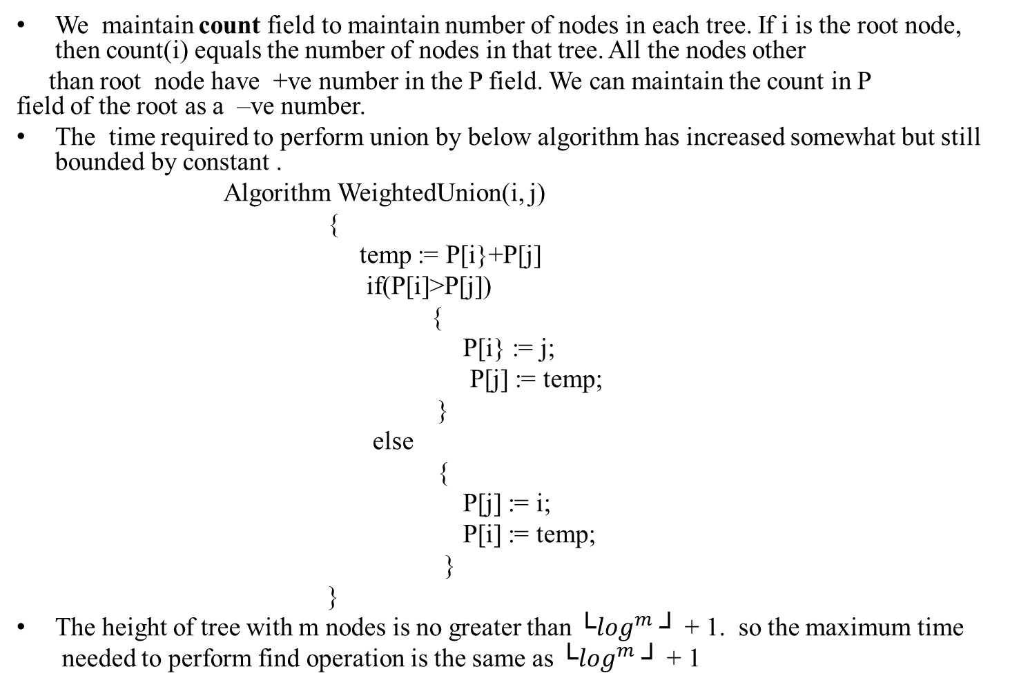
DISJOINT SET OPERATIONS

Slide 12
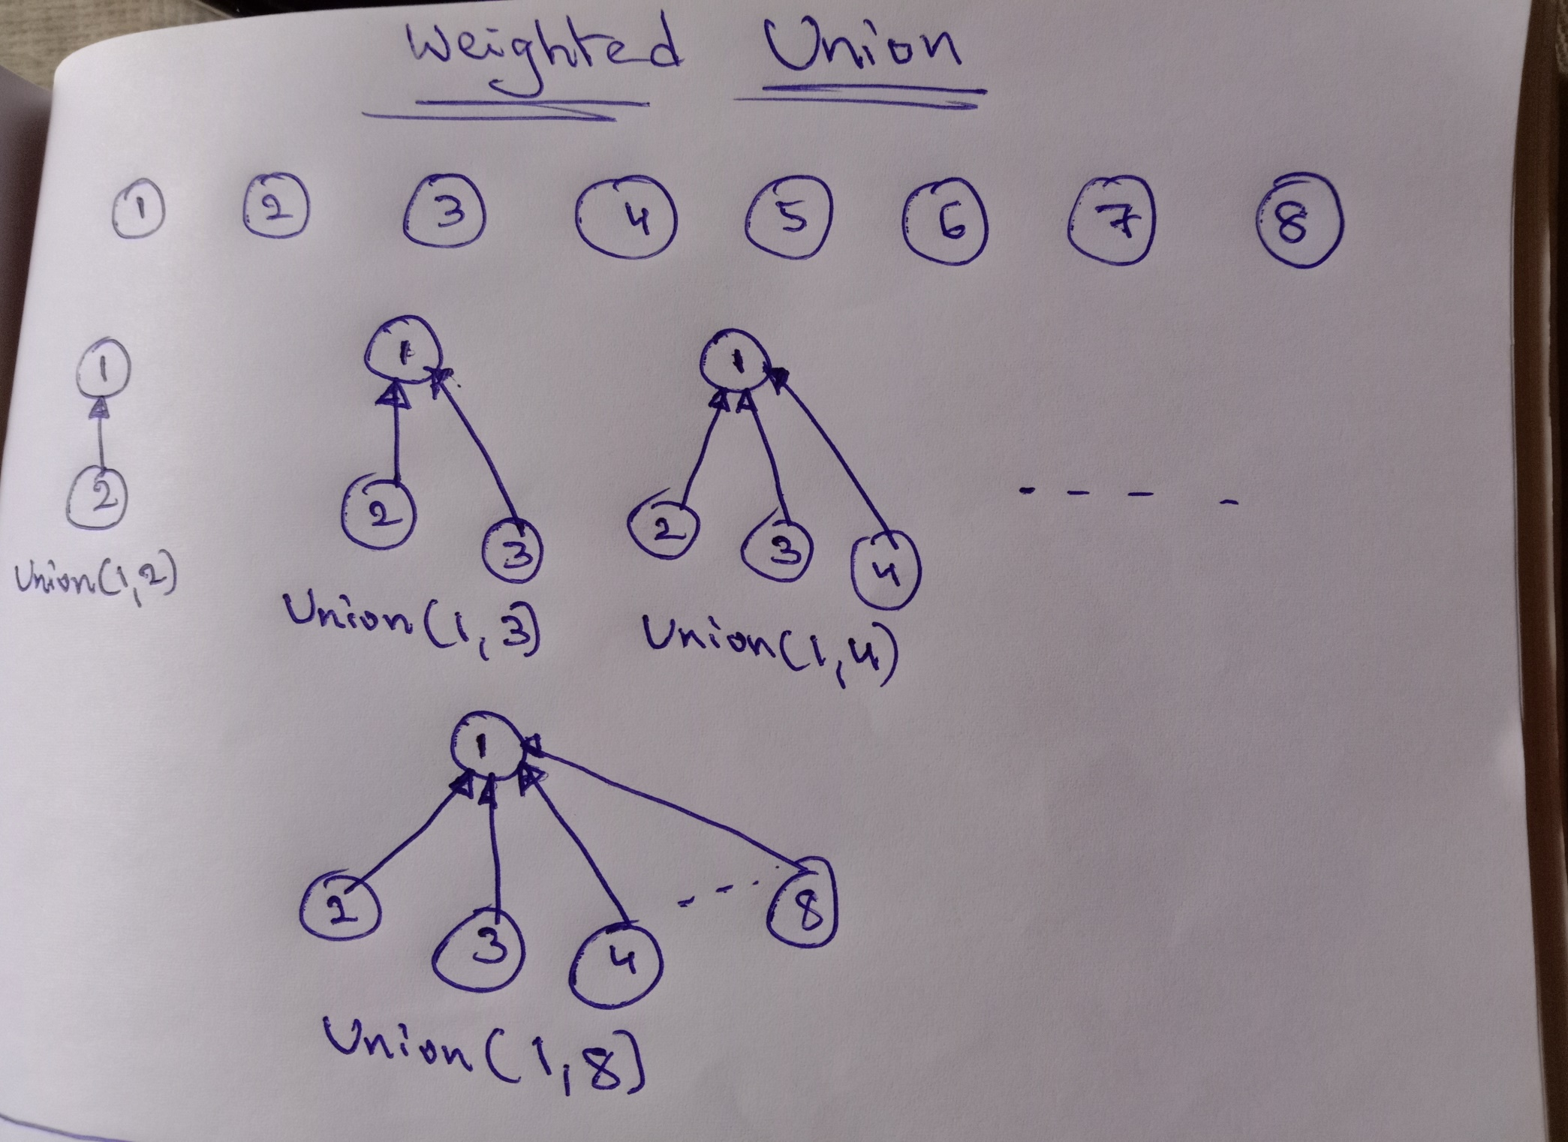

Slide 13
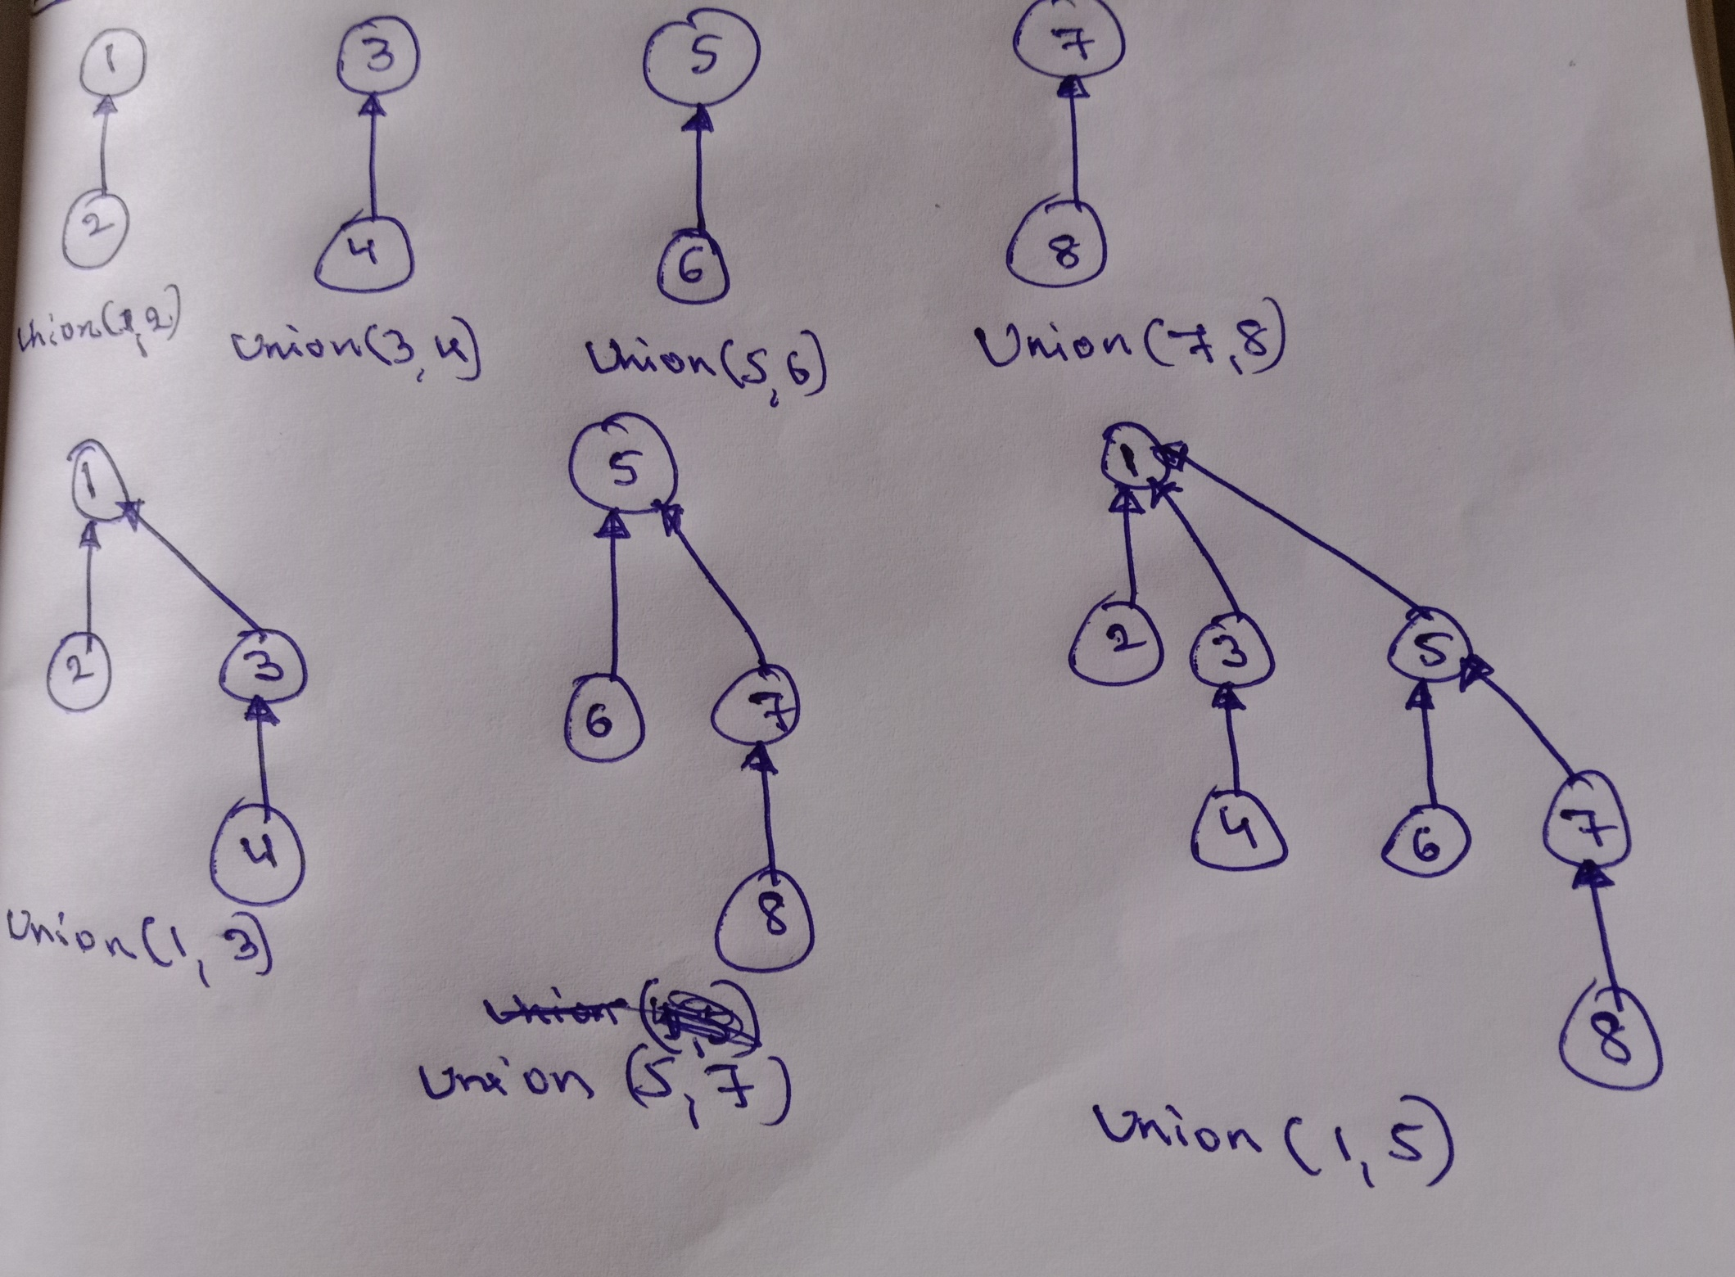

Slide 14
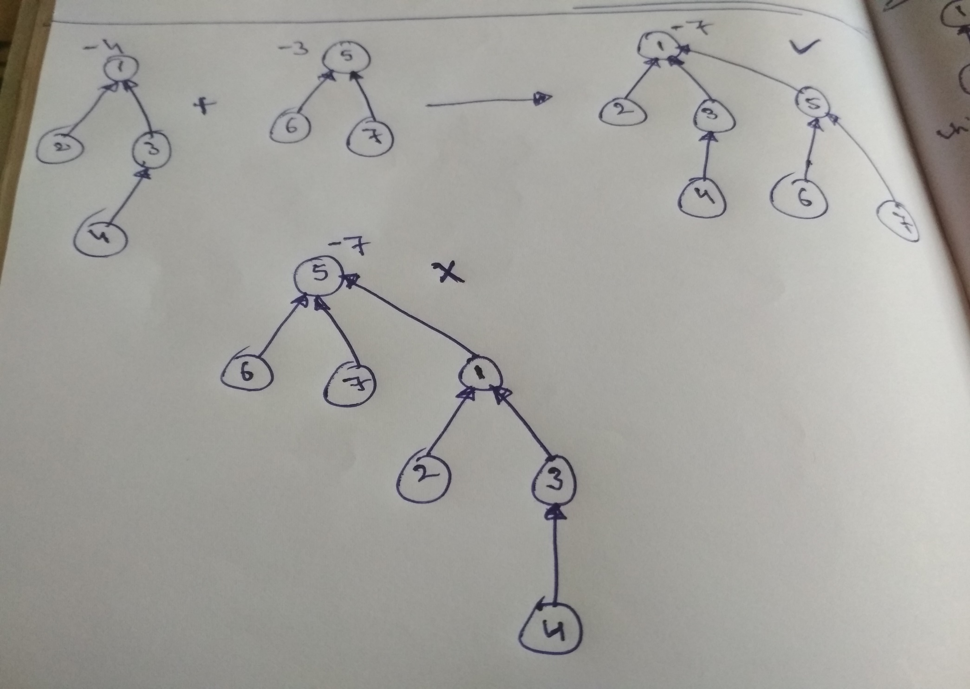

Slide 15
DISJOINT SET OPERATIONS
Collapsing Rule for Find : if j is a node in the path from I to its root and P[i] ≠ root[i] , then set P[j] to the root[i].
Algorithm CollapsingFind(i)
{
r := i;
while( P[r] > 0) do
r := P[r];
while(i ≠ r) do
{
s := P[i];
P[i] := r;
i := s;
}
return r;
}

Slide 16
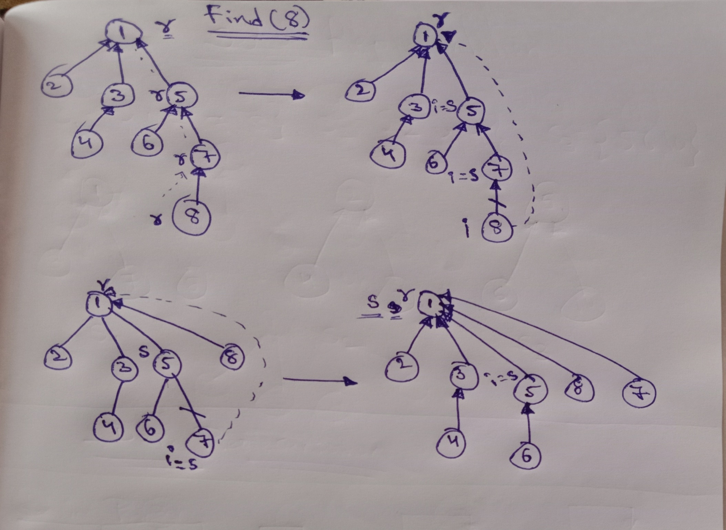

Slide 17
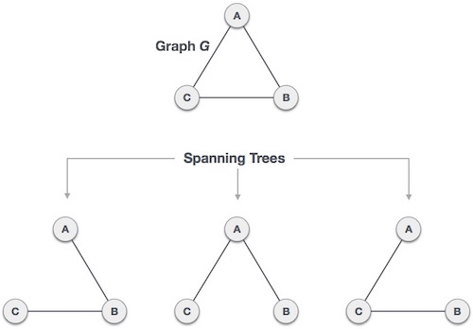
SPANNING TREES
Definition : Let G=(V, E) be an undirected connected graph. A sub-graph t=(V,E’) of G is a spanning tree of G if t is a tree.
A spanning tree is a subset of Graph G, which has all the vertices covered with minimum possible number of edges. Hence, a spanning tree does not have cycles and it cannot be disconnected.
we can draw a conclusion that every connected and undirected Graph G has at least one spanning tree. A disconnected graph does not have any spanning tree, as it cannot be spanned to all its vertices.
A complete undirected graph can have maximum n^{n-2} number of spanning trees, where n is the number of nodes.

Slide 18
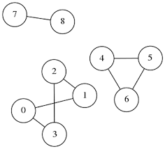
CONNECTED COMPONENTS
Definition : A connected component of an undirected graph is a maximal set of nodes such that each pair of nodes is connected by a path.
Connected components form a partition of the set of graph vertices, meaning that connected components are non-empty, they are pairwise disjoints, and the union of connected components forms the set of all vertices.
Equivalently, we can say that the relation that associates two nodes if and only if they belong to the same connected component is an equivalence relation, that is it is reflexive, symmetric, and transitive.

Slide 19
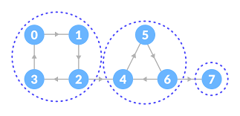
CONNECTED COMPONENTS
Strongly Connected Components : Strong Connectivity applies only to directed graphs. A directed graph is strongly connected if there is a directed path from any vertex to every other vertex. This is same as connectivity in an undirected graph, the only difference being strong connectivity applies to directed graphs and there should be directed paths instead of just paths. Similar to connected components, a directed graph can be broken down into Strongly Connected Components.

Slide 20
Bi- CONNECTED COMPONENT
Definition : A biconnected component of a graph is a connected subgraph that cannot be broken into disconnected pieces by deleting any single node (and its incident links). An articulation point is a node of a graph whose removal would cause an increase in the number of connected components. Articulation points can be important when you analyse any graph that represents a communications network.
A bi-connected component (sometimes known as a 2-connected component) is a maximal bi-connected sub-graph. Any connected graph decomposes into a tree of bi-connected components called the block-cut tree of the graph. The blocks are attached to each other at shared vertices called cut vertices or articulation points. Specifically, a cut vertex is any vertex whose removal increases the number of connected components.
A graph is said to be Biconnected if:
-It is connected, i.e. it is possible to reach every vertex from every other vertex, by a simple path.
-Even after removing any vertex the graph remains connected.
A bi-connected graph is a connected and “Nonseperable” graph.

Slide 21
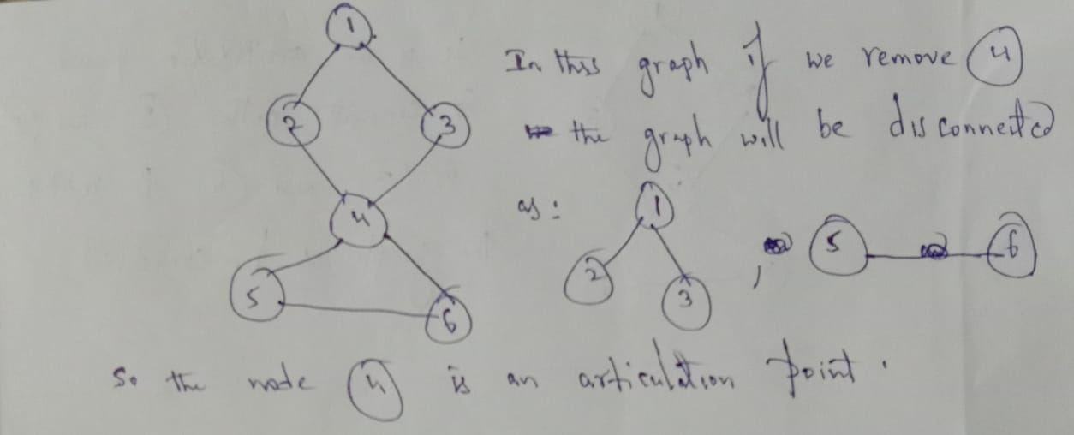

Slide 22
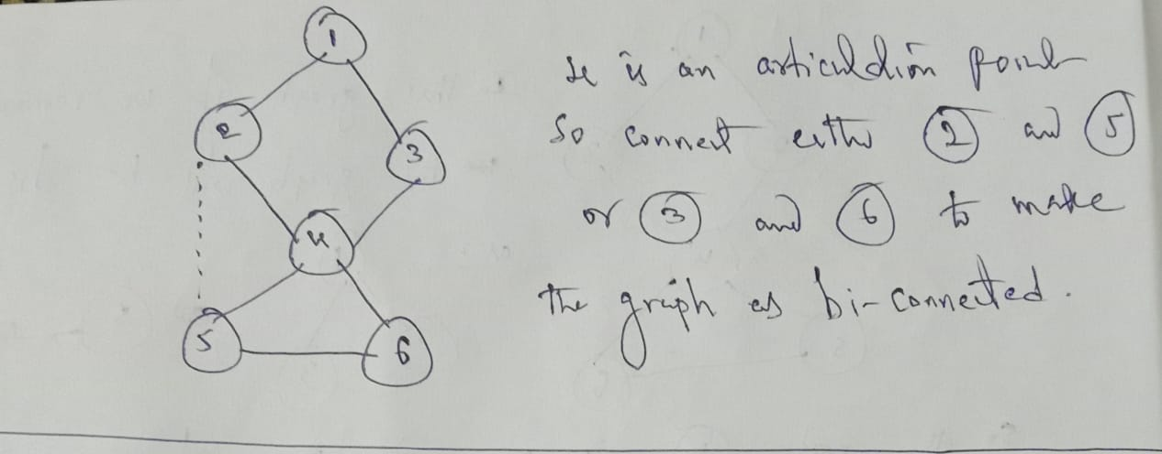

Slide 23
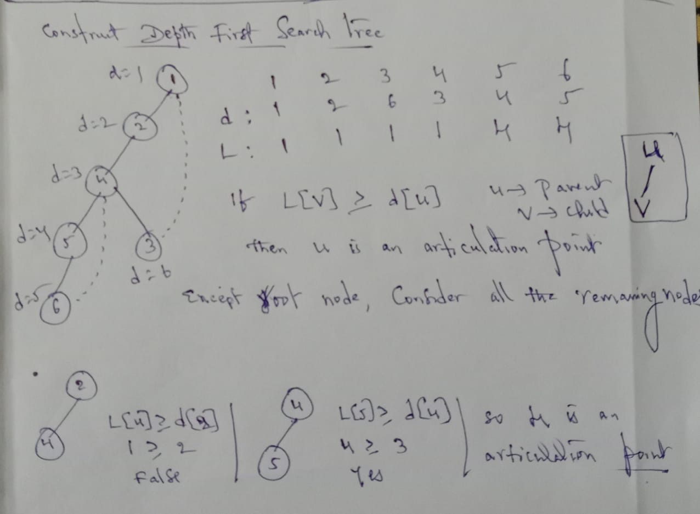

Slide 24
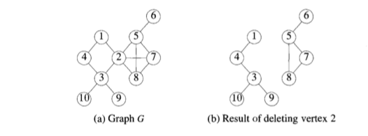
EXAMPLE:

Slide 25
DIVIDE AND CONQUER

Slide 26
GENERAL METHOD
Given a function to compute on n-inputs the Divide-and-Conquer(DAC) strategy suggests splitting the input into k distinct subsets, 1 < k ≤ n, yielding k sub-problems. These
sub-problems must be solved, and then the method must be found to combine solutions into a solution of a whole problem.
The below algorithm is a general method of Divide-and-Conquer.
Algorithm DandC(P)
{
if Small(P) then return S(P)
else
{
divide P into smaller instances P1, P2….Pk, K>1;
apply DandC to each of these sub-problems;
return Combine(Dandc(P1), DandC(P2)…..DandC(Pk));
}
}
Small(P) is a boolean valued function that determines whether the input size is small enough that the answer can be completed without splitting.

Slide 27
GENERAL METHOD
Combine is the function that determines the solution to P using using the solution to the k sub-problems.
The computing time of DandC is described by the following recurrence relation:
g(n) if n is small
T(n) =
T(n1) + T(n2) + ……+ T(nk) + f(n) other
Where g(n) is the time to compute the answer directly without splitting and T(n) is the time for DandC on any input size n.
The computing time of DandC is described by the following recurrence relation:
T(1) if n=1
T(n) =
aT(n/b) + f(n) if n>1
Where a and b are known constants

Slide 28
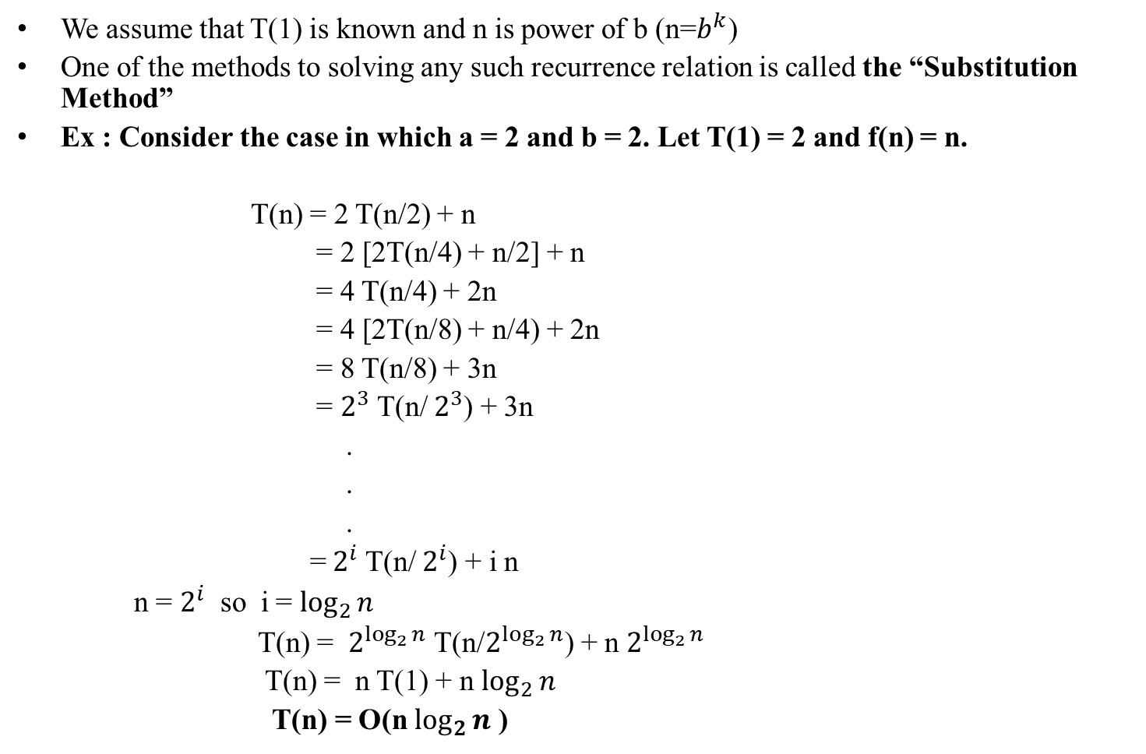
GENERAL METHOD

Slide 29
APPLICATIONS
OF
DIVIDE – AND - CONQUER

Slide 30
BINARY SEARCH
Let A[i] , 1<=i<=n, be a list of elements, that are sorted in increasing order. Consider the problem of determining whether the given element x is present in the list.
If x is present, we determine a value j such that A[j]=x . If x is not there in the list then j is set to zero.
Let P=(n, A[i], A[i+1], ……. , A[l], x) denote an arbitrary instance of this search problem.
Let Small(P) be true if n=1. In this case S(P) will take the value i if A[i}=x , otherwise it will take the value zero.
If P has more than one element, it can be divided into new sub-problems as: pick an index q in the range [i, l] and compare x with A[q], there are three possibilities :
X=A[q] : in this case the problem P is immediately solved
X<a[q]: in this case x has to be searched for only in the subset A[i], A[i+1],….A[q-1] so the problem instance is (q-i, A[i], A[i+1],…..,A[q-1], x).
X>A[q]: in this case the subset to be searched is A[q+1], A[q+2],……, A[l] so the problem instance is (l-q, A[q+1], A[q+2],……, A[l] , x)

Slide 31
BINARY SEARCH
Binary search is implemented using following steps...
Step 1 - Read the search element from the user.
Step 2 - Find the middle element in the sorted list.
Step 3 - Compare the search element with the middle element in the sorted list.
Step 4 - If both are matched, then display "Given element is found!!!" and terminate the function.
Step 5 - If both are not matched, then check whether the search element is smaller or larger than the middle element.
Step 6 - If the search element is smaller than middle element, repeat steps 2, 3, 4 and 5 for the left sublist of the middle element.
Step 7 - If the search element is larger than middle element, repeat steps 2, 3, 4 and 5 for the right sublist of the middle element.
Step 8 - Repeat the same process until we find the search element in the list or until sublist contains only one element.
Step 9 - If that element also doesn't match with the search element, then display "Element is not found in the list!!!" and terminate the function.

Slide 32
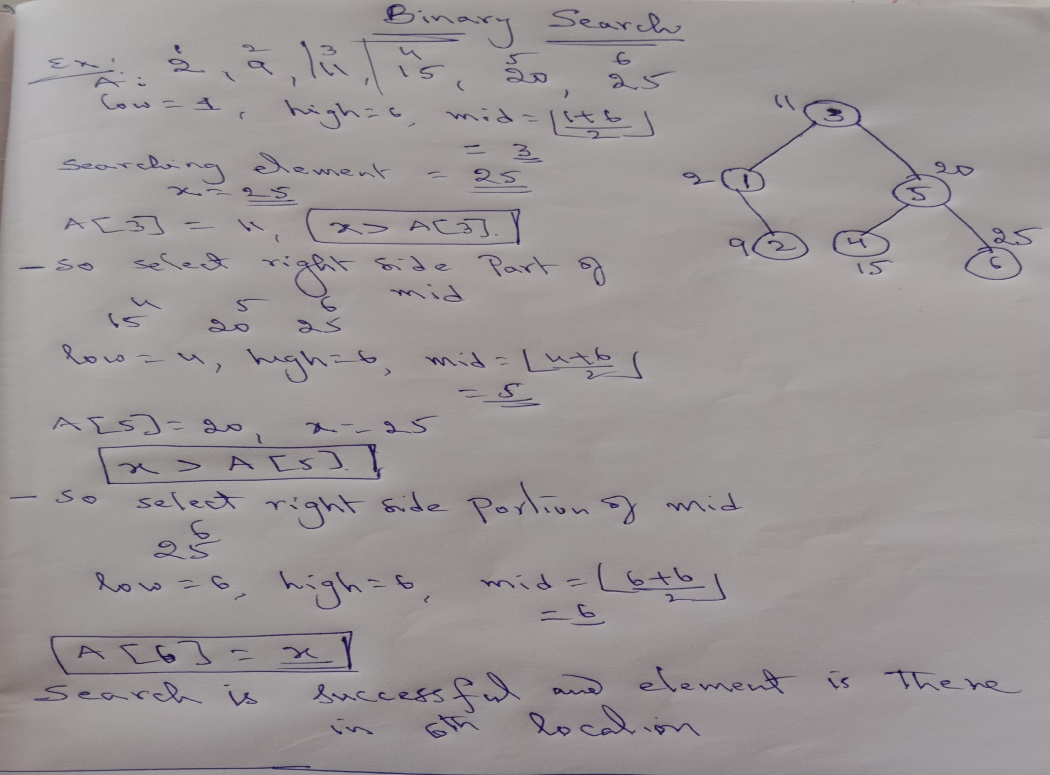

Slide 33
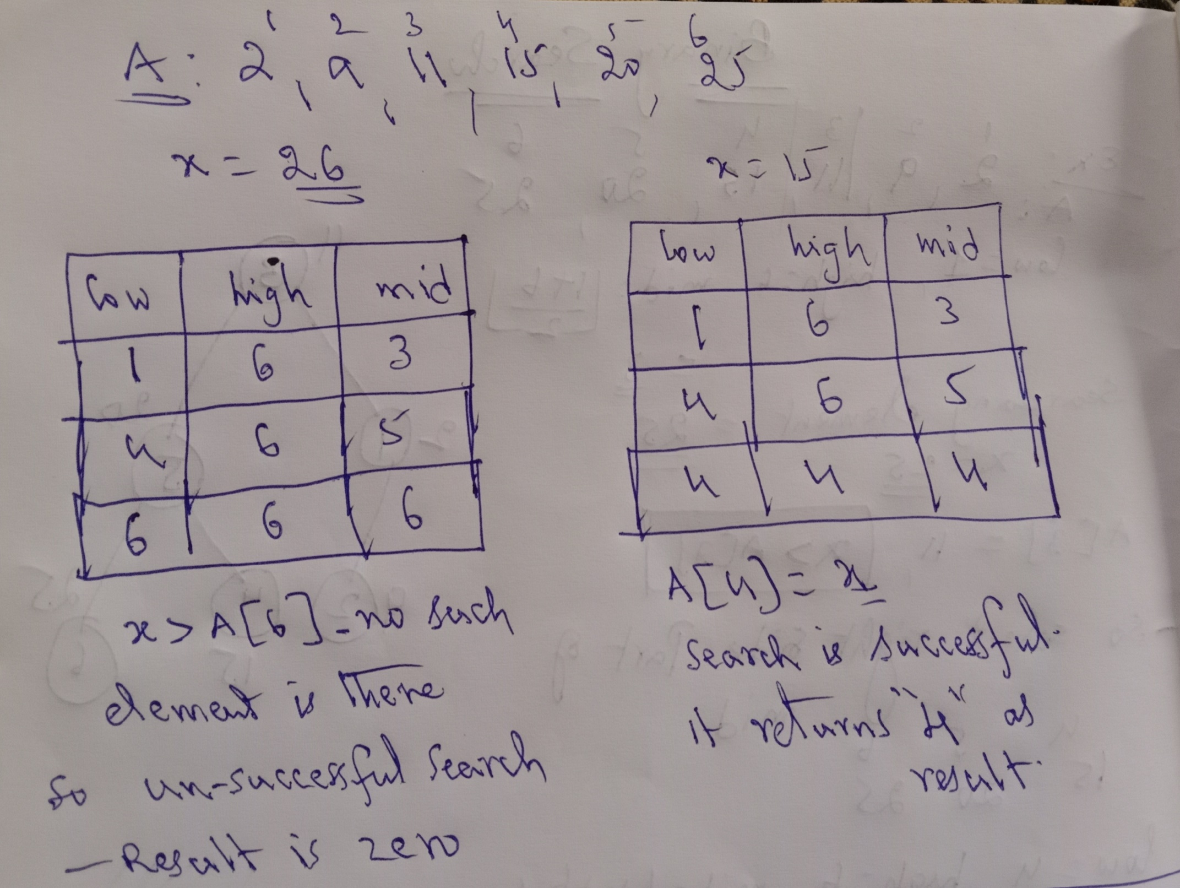

Slide 34
BINARY SEARCH
Algorithm BinSrch(a, low, high, x)
{
if( low = high)
{
if(x = a[high]) then return high;
else return 0;
}
else
{
mid := └(low+high)/2┘;
if (x = a[mid]) then return mid;
else if(x < a[mid]) then
return BinSrch(a, low, mid-1, x);
else return BinSrch(a, mid+1, high, x);
}
}

Slide 35
BINARY SEARCH
Complexity
SN | Performance | Complexity
1 | Worst case time complexity | O(log n)
2 | Best case time complexity | O(1)
3 | Average Case time complexity | O(log n)
4 | Worst case space complexity | O(1)

Slide 36
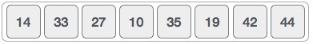
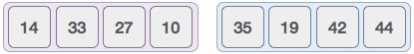
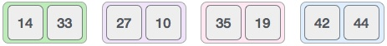
MERGE SORT
Merge sort is a sorting technique based on divide and conquer technique. With worst-case time complexity being Ο(n log n), it is one of the most respected algorithms.
Merge sort first divides the array into equal halves and then combines them in a sorted manner.
To understand merge sort, we take an unsorted array as the following −
We know that merge sort first divides the whole array iteratively into equal halves unless the atomic values are achieved. We see here that an array of 8 items is divided into two arrays of size 4.
This does not change the sequence of appearance of items in the original. Now we divide these two arrays into halves.
We further divide these arrays and we achieve atomic value which can no more be divided
.

Slide 37
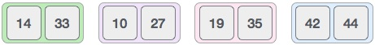
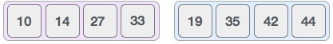
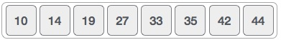
MERGE SORT
Now, we combine them in exactly the same manner as they were broken down. Please note the color codes given to these lists.
We first compare the element for each list and then combine them into another list in a sorted manner. We see that 14 and 33 are in sorted positions. We compare 27 and 10 and in the target list of 2 values we put 10 first, followed by 27. We change the order of 19 and 35 whereas 42 and 44 are placed sequentially.
In the next iteration of the combining phase, we compare lists of two data values, and merge them into a list of found data values placing all in a sorted order.
After the final merging, the list should look like this −

Slide 38
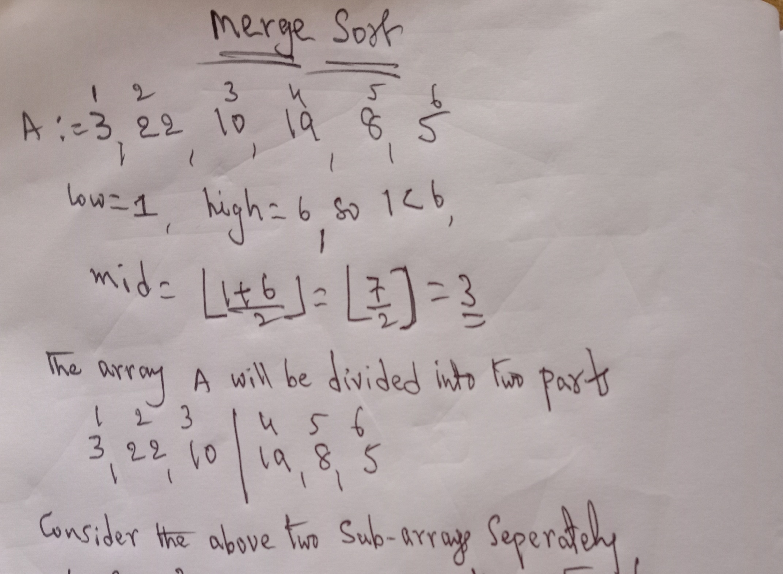

Slide 39
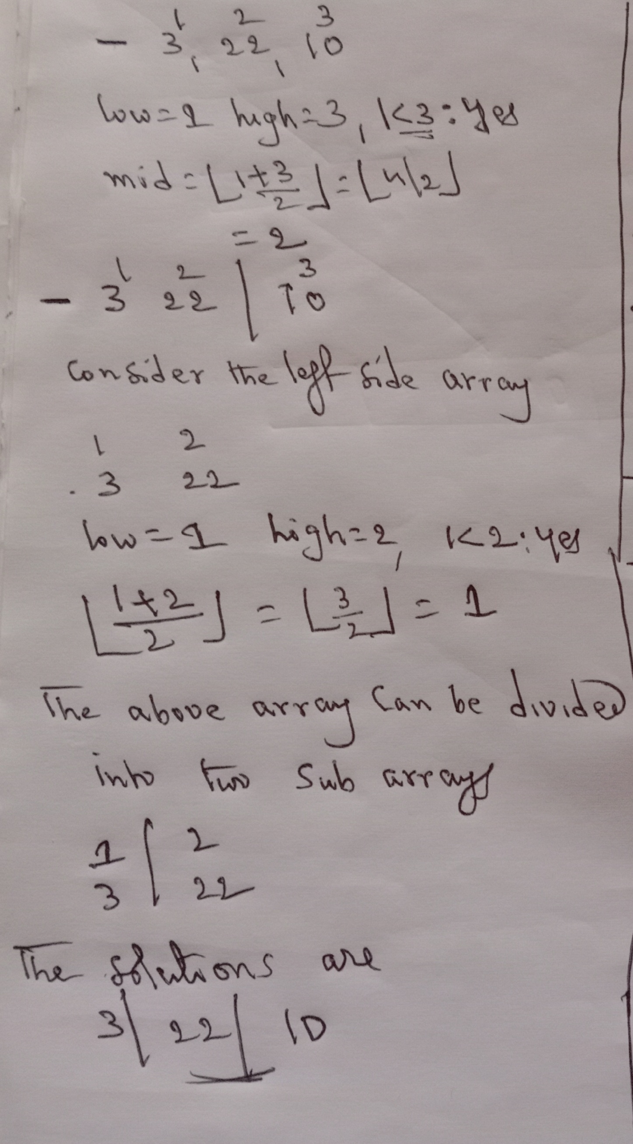

Slide 40
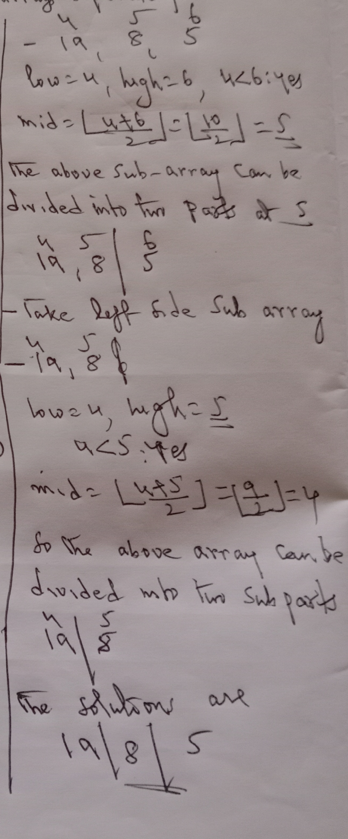

Slide 41
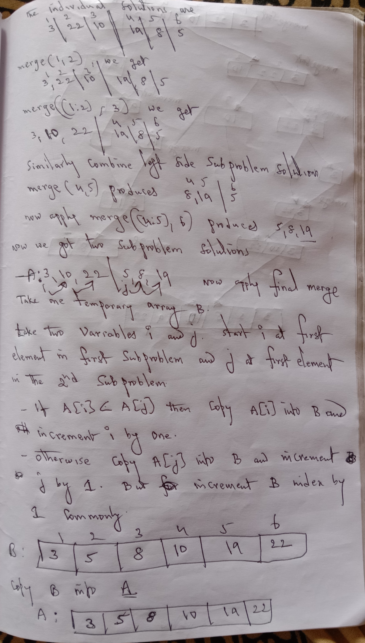

Slide 42
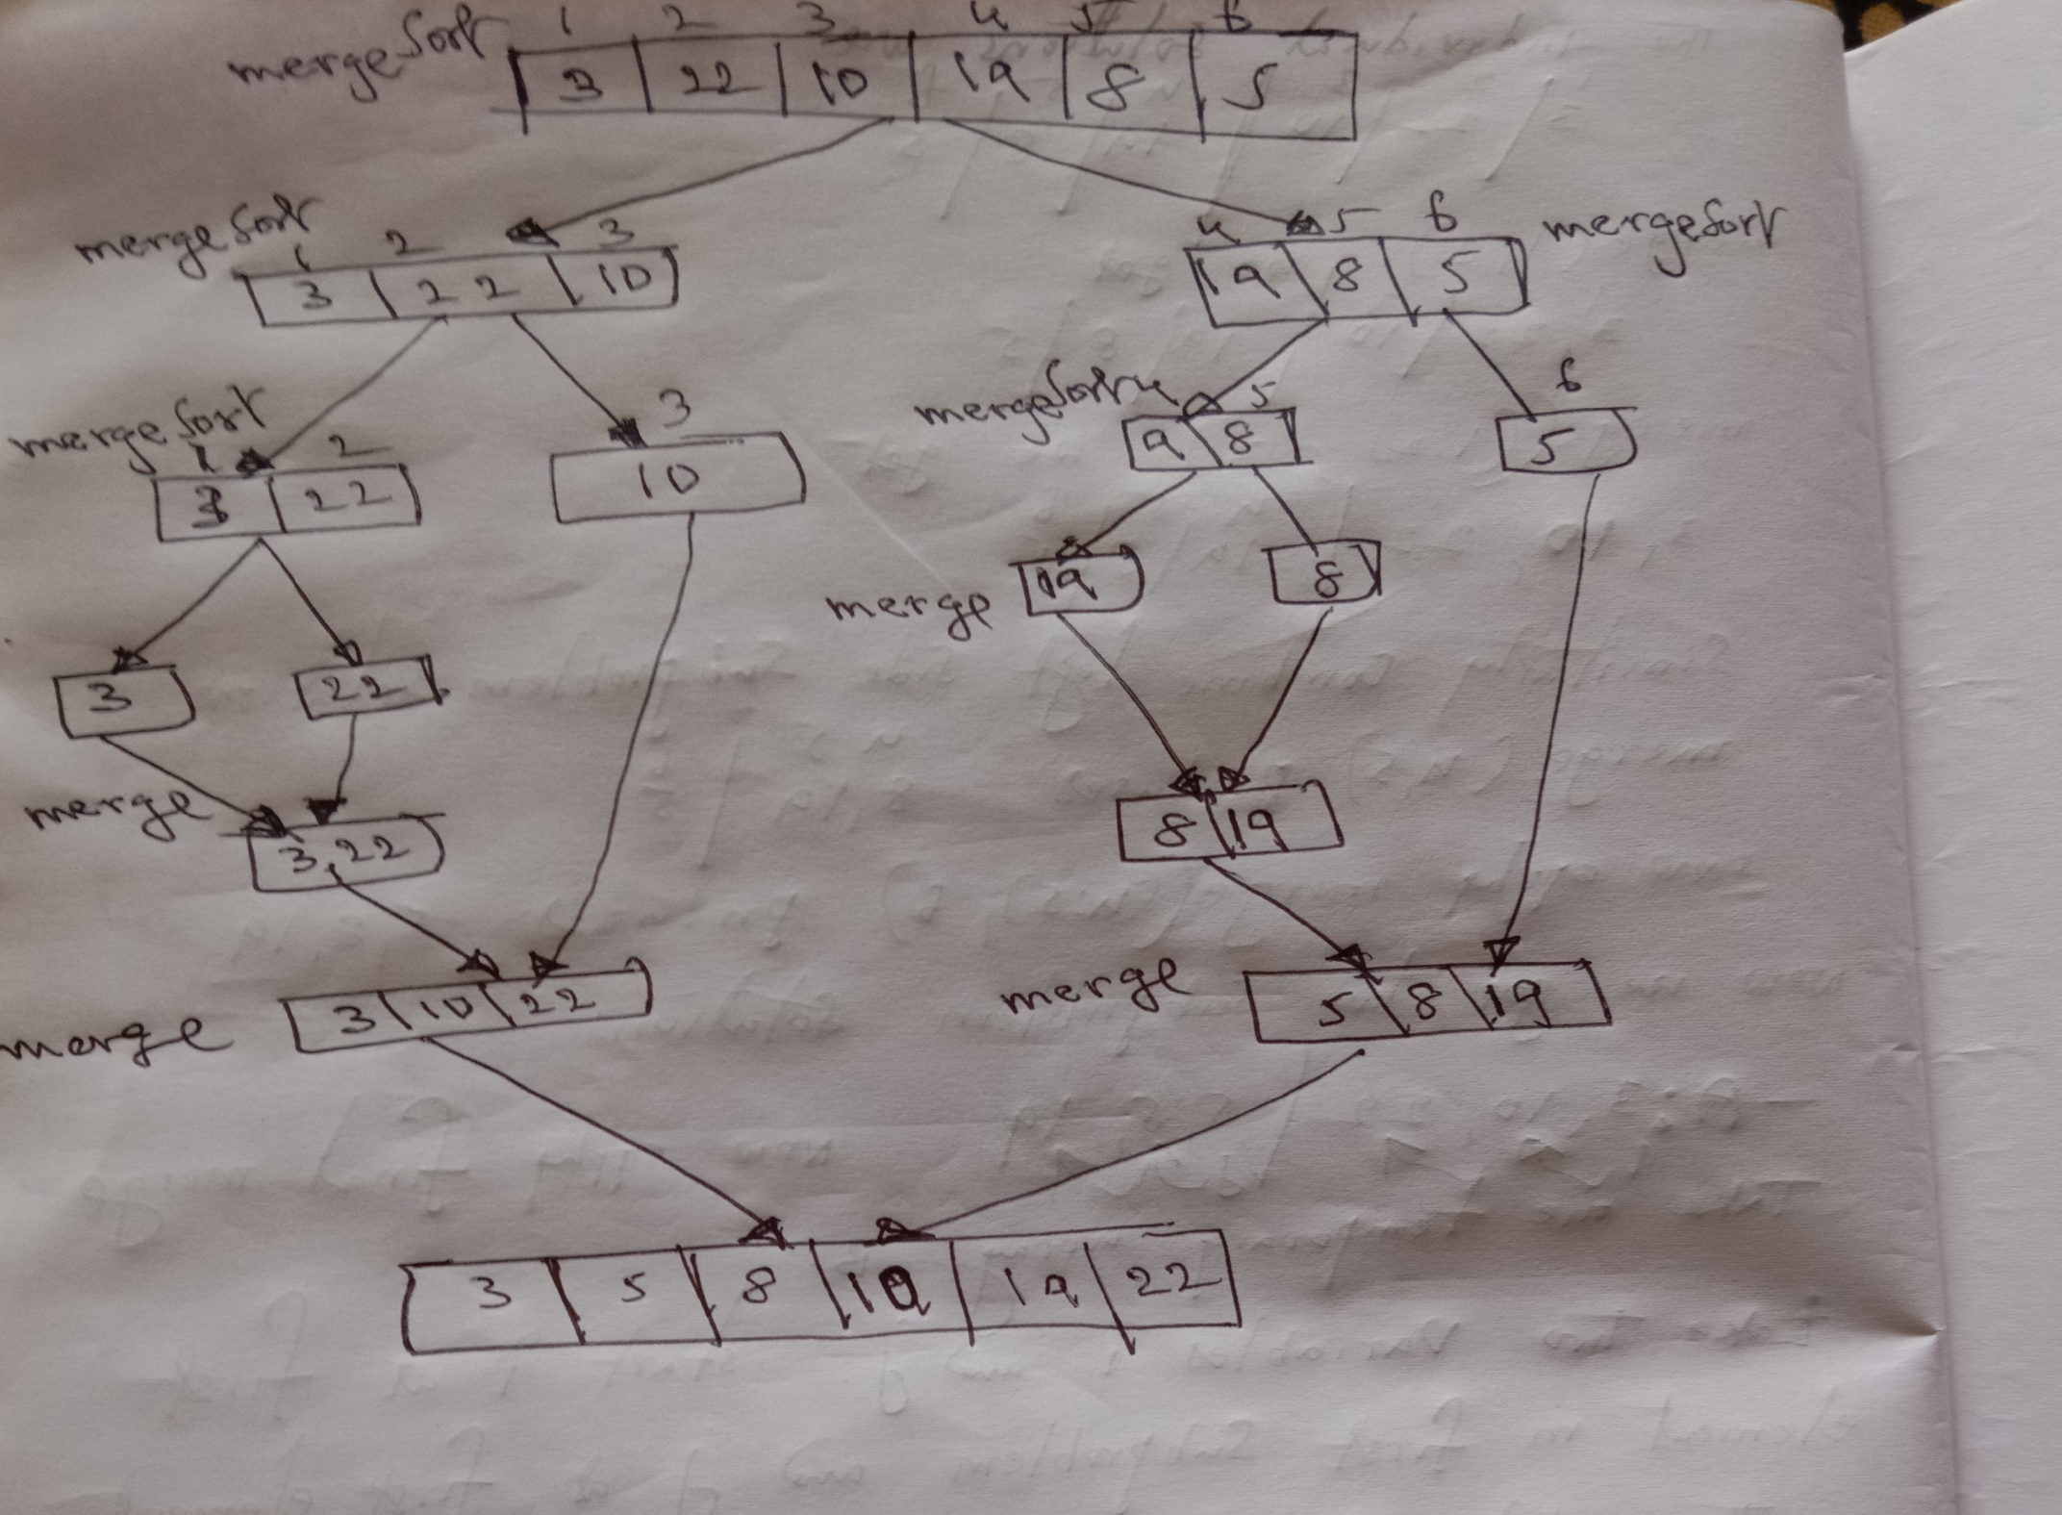

Slide 43
MERGE SORT
Algorithm MergeSort(low, high)
{
if(low < high)
{
mid := └(low + high)/2┘;
MergeSort(low, mid);
MergeSort(mid+1, high);
Merge(low, mid, high);
}
}

Slide 44
MERGE SORT
Algorithm Merge(low, mid, high)
{
h := low, i := low, j := mid+1;
while((h ≤ mid) and (j ≤ high))
{
if( a[h] ≤ a[j])
{
b[i] = a[h];
h := h+1;
}
else
{
b[i] := a[j];
j := j+1;
}
i := i+1;
}

Slide 45
MERGE SORT
if(h > mid) then
for k := j to high do
{
b[i] := a[k];
i ;= i+1;
}
else
for k:= h to mid do
{
b[i] := a[k];
i := i+1;
}
for k := low to high do
a[k] := b[k];
}

Slide 46
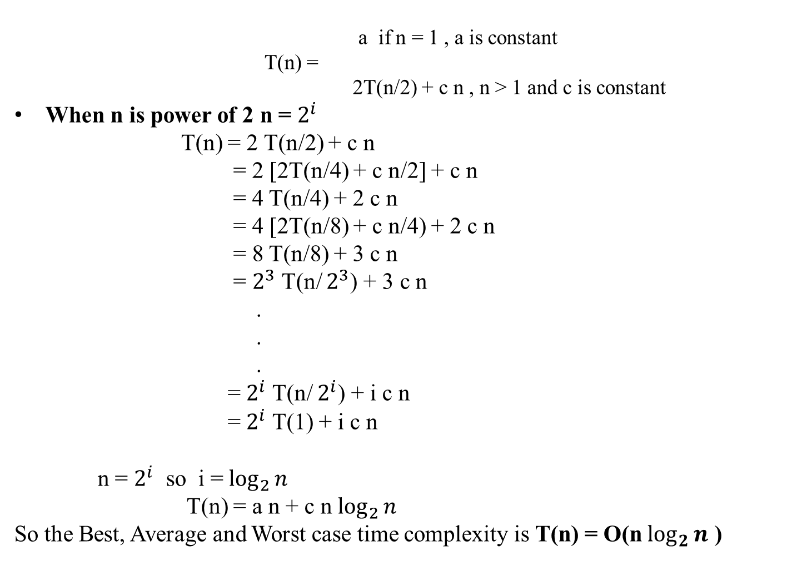
MERGE SORT

Slide 47
QUICK SORT
Quick sort is a fast sorting algorithm used to sort a list of elements. Quick sort algorithm is invented by C. A. R. Hoare.
The quick sort algorithm attempts to separate the list of elements into two parts and then sort each part recursively.
That means it use divide and Conquer strategy. In quick sort, the partition of the list is performed based on the element called pivot. Here pivot element is one of the elements in the list.
The list is divided into two partitions such that "all elements to the left of pivot are smaller than the pivot and all elements to the right of pivot are greater than or equal to the pivot".

Slide 48
QUICK SORT
Algorithm QuickSort(p, q)
{
if(p < q) then
{
j := Partition(a, p, q+1);
QuickSort(p, j-1);
QuickSort(j+1, q);
}
}
The procedure Partition( ) takes the input as a problem and partitions the problem into two sub problems at the partitioning element j.
Those two sub problems can be also solved using the same procedure.
This procedure continues upto the total problem is solved completley.

Slide 49
QUICK SORT
Step by Step Process of Partition( ):
In Quick sort algorithm, partitioning of the list is performed using following steps...
Step 1 - Consider the first element of the list as pivot (i.e., Element at first position in the list).
Step 2 - Define two variables i and j. Set i and j to first and last elements of the list respectively.
Step 3 - Increment i until list[i] > pivot then stop.
Step 4 - Decrement j until list[j] < pivot then stop.
Step 5 - If i < j then exchange list[i] and list[j].
Step 6 - Repeat steps 3,4 & 5 until i > j.
Step 7 - Exchange the pivot element with list[j] element.

Slide 50
QUICK SORT
Algorithm Partition(a, m, p)
{
v := a[m], i :=m, j :=p;
repeat
{
repeat
i := i+1;
until (a[i] >= v);
repeat
j := j-1;
until (a[j] <= v);
if (i < j)
{
t : = a[i];
a[i] := a[j];
a[j] := t;
}
} until (i >= j);
a[m] := a[j];
a[j] := v;
return j;
}

Slide 51
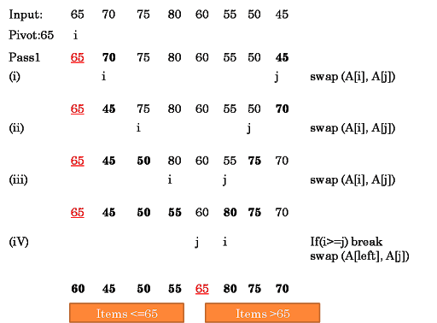
QUICK SORT

Slide 52
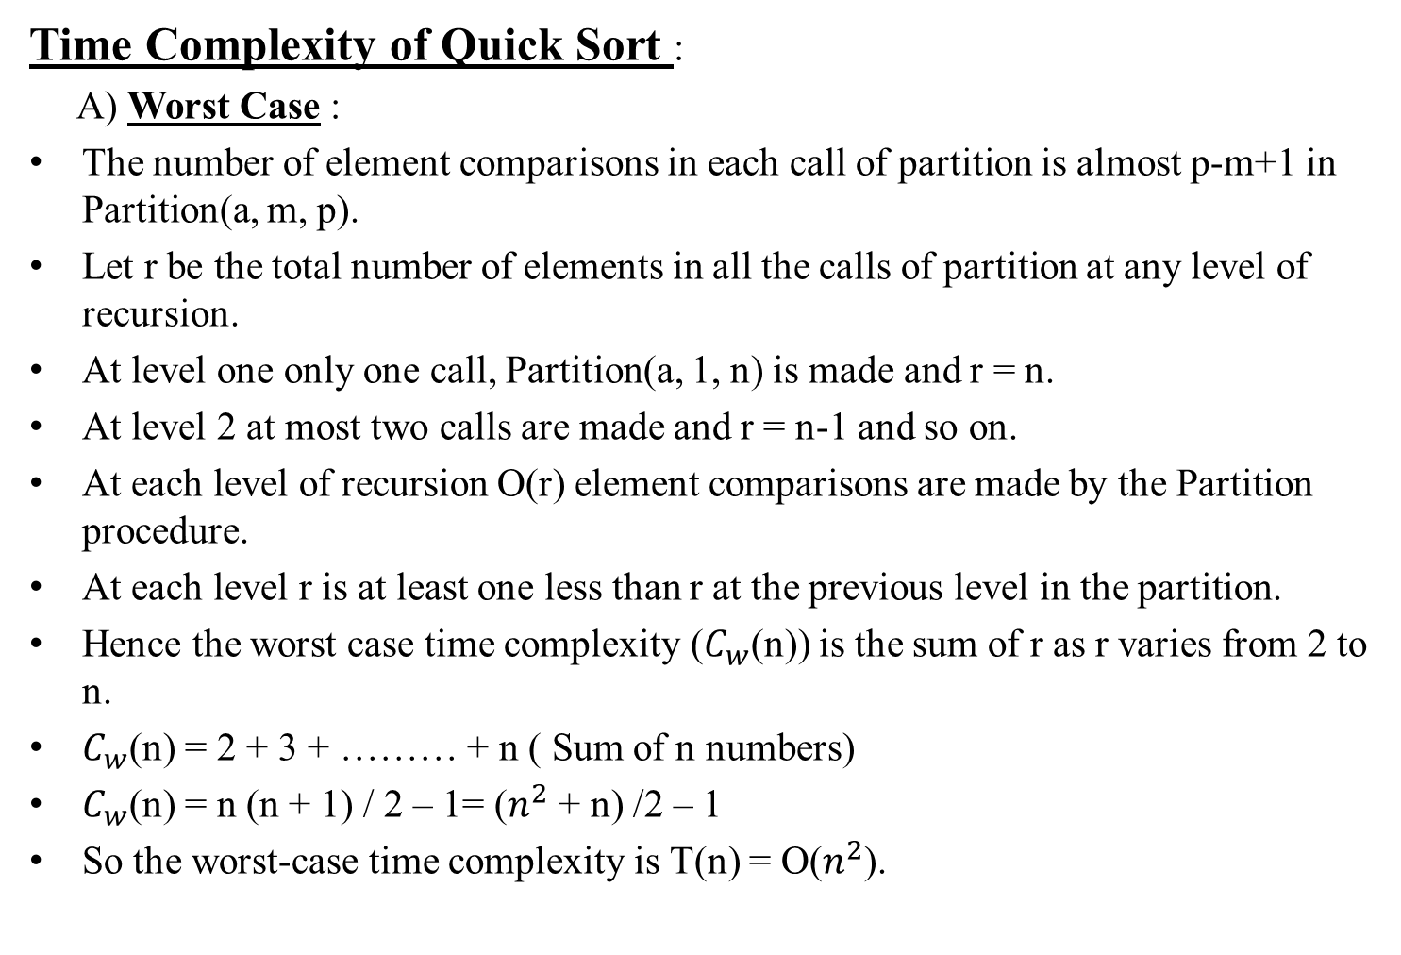
QUICK SORT

Slide 53
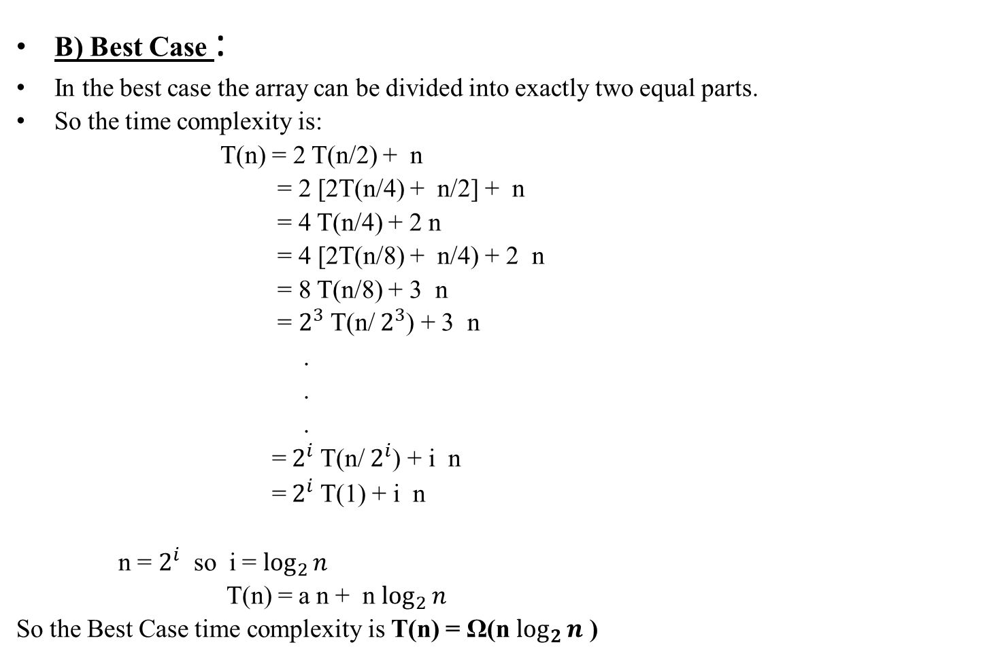
QUICK SORT

Slide 54
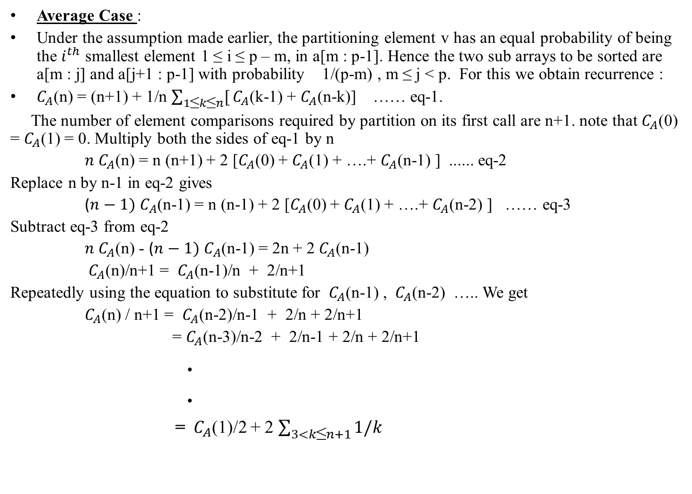
QUICK SORT

Slide 55
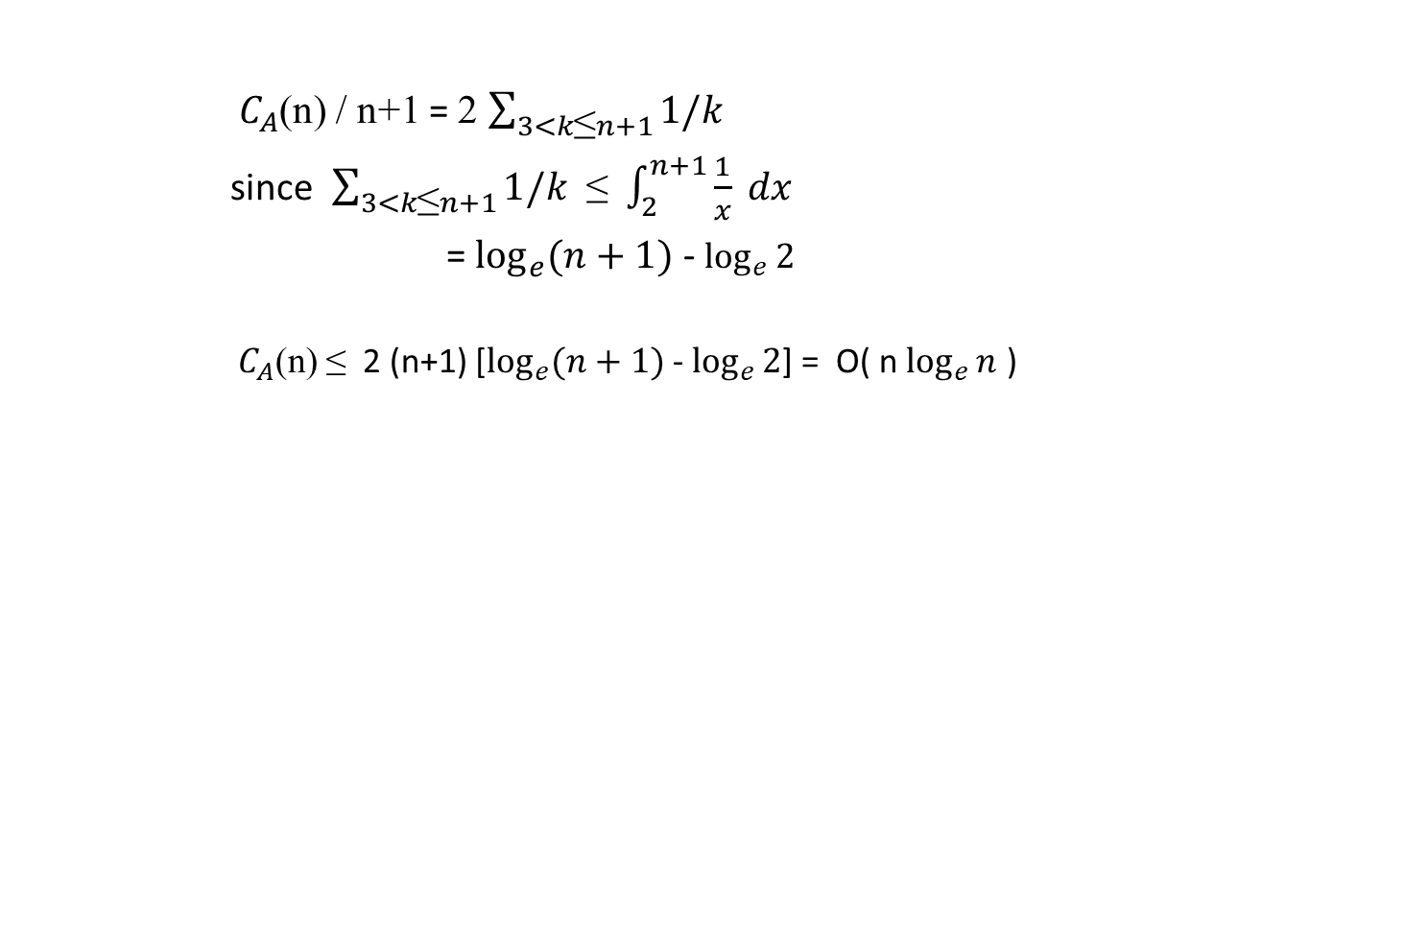
QUICK SORT

Slide 56
STRASSEN’s MATRIX MULTIPLICATION
In linear algebra, the Strassen algorithm, named after Volker Strassen, is an algorithm for matrix multiplication. It is faster than the standard matrix multiplication algorithm and is useful in practice for large matrices, but would be slower than the fastest known algorithms for extremely large matrices.
Naive Method : Following is a simple way to multiply two matrices
void multiply(int A[][N], int B[][N], int C[][N]) { for (int i = 0; i < N; i++) { for (int j = 0; j < N; j++) { C[i][j] = 0; for (int k = 0; k < N; k++) { C[i][j] += A[i][k]*B[k][j]; } } } } Time Complexity of above method is O(N³).

Slide 57
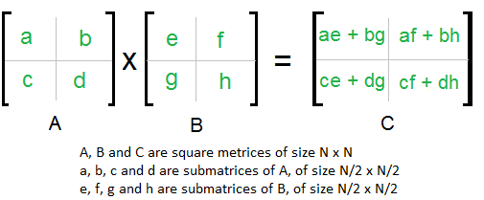
STRASSEN’s MATRIX MULTIPLICATION
Divide and Conquer : Following is simple Divide and Conquer method to multiply two square matrices. 1) Divide matrices A and B in 4 sub-matrices of size N/2 x N/2 as shown in the below diagram. 2) Calculate following values recursively. ae + bg, af + bh, ce + dg and cf + dh.
In the above method, we do 8 multiplications for matrices of size N/2 x N/2 and 4 additions. Addition of two matrices takes O(N²) time.
So the time complexity can be written as T(N) = 8T(N/2) + O(N²) From Master's Theorem, time complexity of above method is O(N³) which is unfortunately same as the above naive method.

Slide 58
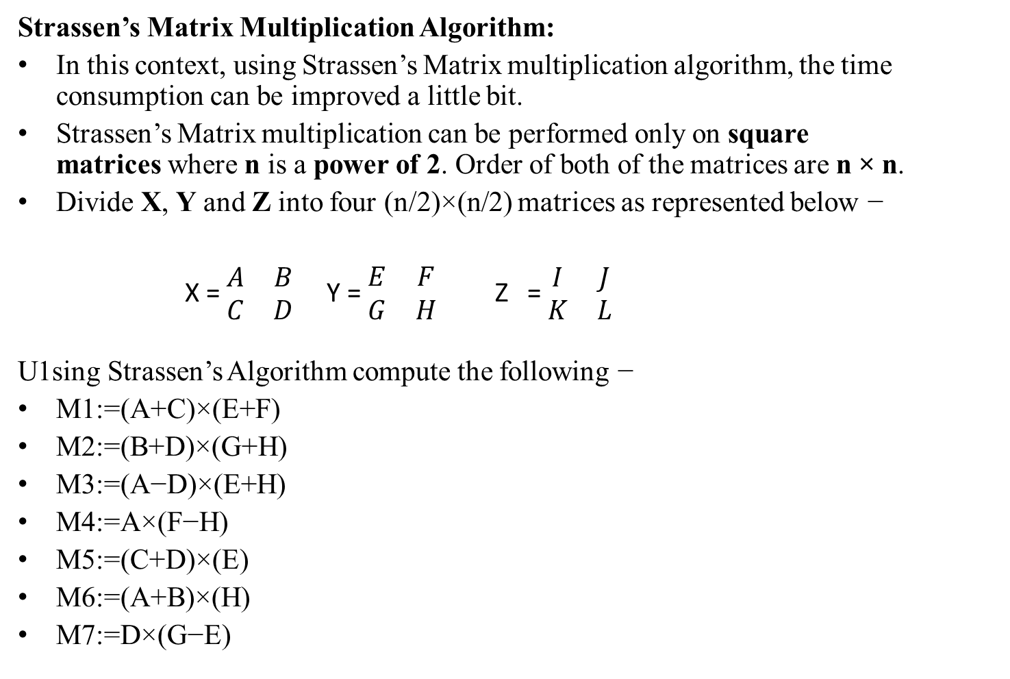
STRASSEN’s MATRIX MULTIPLICATION

Slide 59
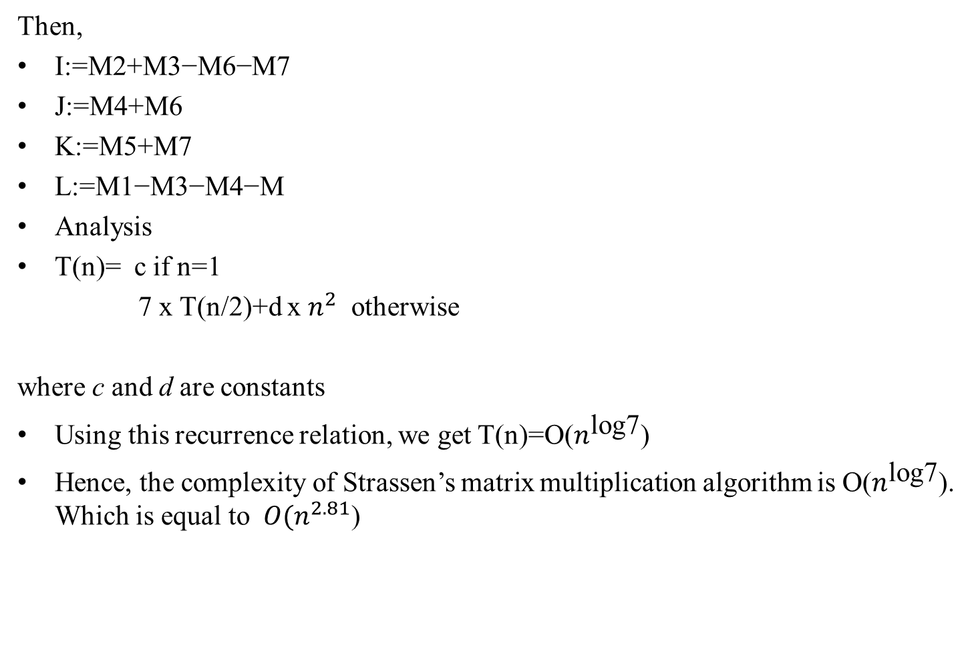
STRASSEN’s MATRIX MULTIPLICATION

